Slide 1


Department of Information and Communication Technology
Course Title: Wireless and Mobile Communication
Wireless Personal Area Network (WPAN)
Presented By:
Course Teacher:
Md. Shafi Mahmud
Dr. Nazrul Islam
ID: IT-21001
Associate Professor
Notes:
Click to add Notes

Slide 2



Introduction to Wireless Personal Area Networks (WPAN)
Defining Scope
Primary Function
Key Standard
WPANs are low-power, short-range wireless networks connecting devices within a small, personal operating space, typically up to 10 meters.
Facilitating communication among personal devices (e.g., smartphones, laptops) and peripherals (e.g., headsets, sensors, wearables).
The fundamental WPAN standard is defined by the IEEE 802.15 working group, alongside other technologies like IrDA.
Notes:
Click to add Notes

Slide 3
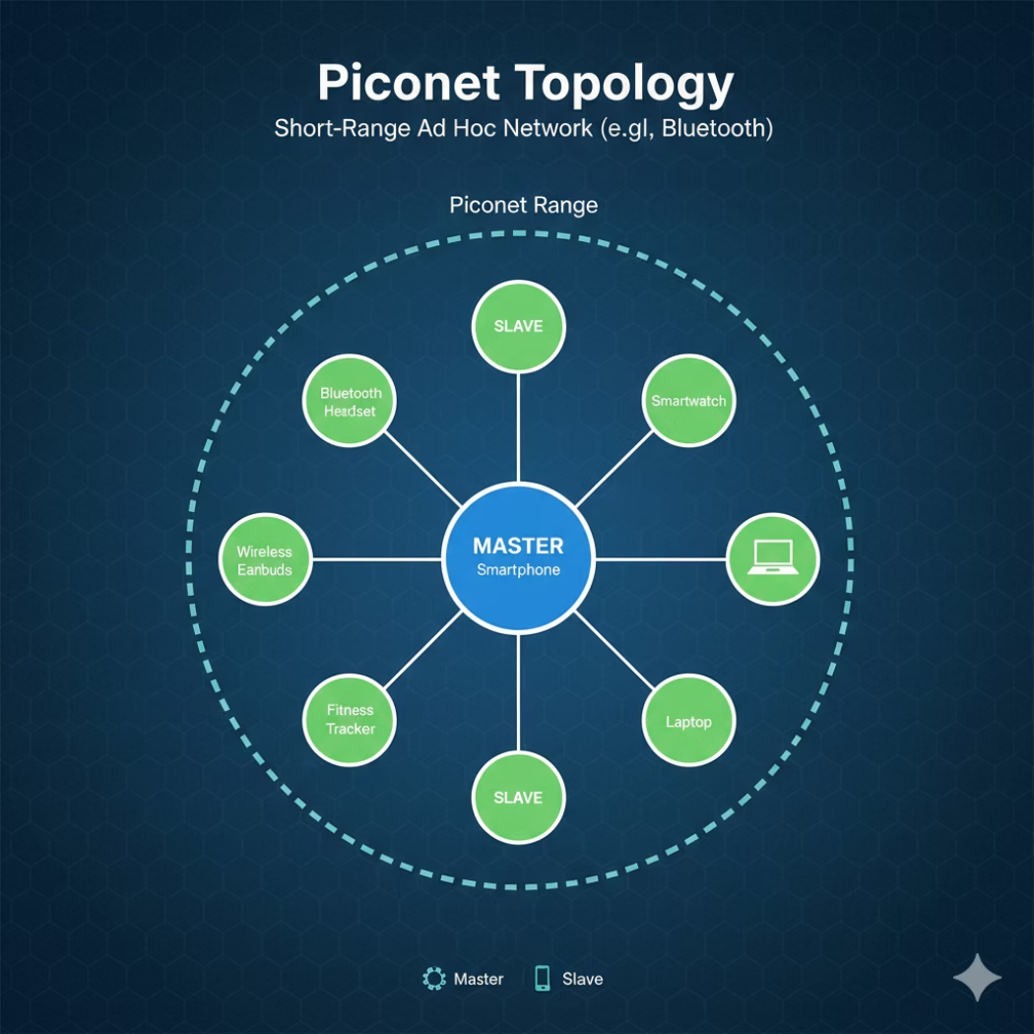
Core Characteristics and Network Topologies
Low Power Consumption
Short Operational Range
Limited Data Throughput
Essential for battery-operated devices and maximizing longevity in sensor applications.
Optimized for small areas (e.g., a room or body), reducing interference with other systems.
Data rates are sufficient for sensor data, control signals, and audio streaming, but not high-definition video.
Common Topologies
Piconet: A star network (e.g., Bluetooth) with one master and several slaves.
Star: Central coordinator manages all communications to and from peripheral nodes.
Mesh: Decentralized network structure allowing nodes to relay data, offering reliability and extended coverage.
Security and latency are critical design constraints, balanced by application needs (e.g., medical devices require low latency).
Notes:
Click to add Notes

Slide 4
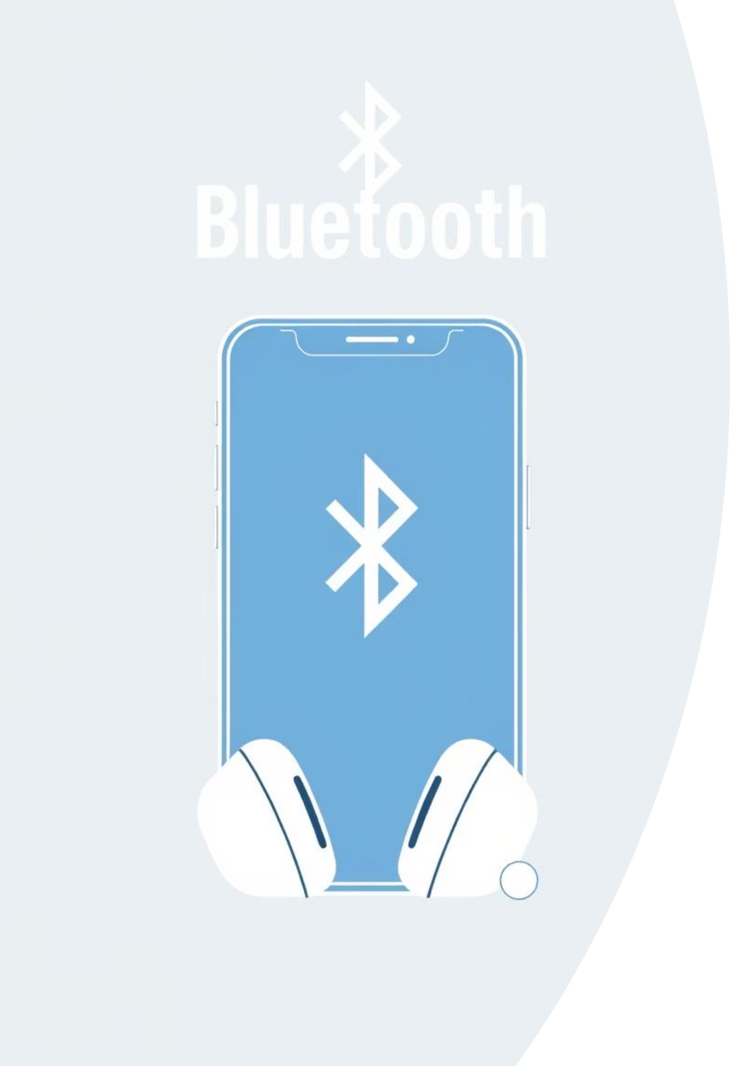
Bluetooth: The Dominant WPAN
Bluetooth Classic (BDR/EDR)
Based on IEEE 802.15.1, operating in the 2.4 GHz ISM band. Supports data rates up to 3 Mbps for streaming and file transfer.
Piconet Architecture
A master device connects up to seven active slave devices within a 10-meter radius, forming a small ad-hoc network.
Bluetooth Low Energy (BLE)
Introduced for efficient connectivity; optimized for sporadic data transmission and coin-cell battery life.
Bluetooth 5 Advancements
Increased speed (up to 2 Mbps in BLE), extended range, and higher broadcast message capacity for IoT.
Notes:
Click to add Notes

Slide 5










ZigBee and IEEE 802.15.4: The IoT Foundation
ZigBee is a communication protocol built upon the IEEE 802.15.4 physical (PHY) and Media Access Control (MAC) layers, specifically designed for robust, low-power, and large-scale sensor networks.
Low Data Rate
Power Optimized
Ideal for small packet data like environmental readings or on/off commands, with typical rates up to 250 kbps.
Focuses on maximum battery life, often allowing devices to run for years on a single charge.
Mesh Networking
Supports complex, self-healing mesh topologies for vast networks of many devices (e.g., smart home lighting systems).
ZigBee 3.0
Unifies earlier standards, enabling interoperability and standardization across diverse product ecosystems.
Frequency Bands
Operates primarily at 2.4 GHz, but also utilizes regional sub-GHz frequencies (868/915 MHz) for better penetration.
Notes:
Click to add Notes

Slide 6
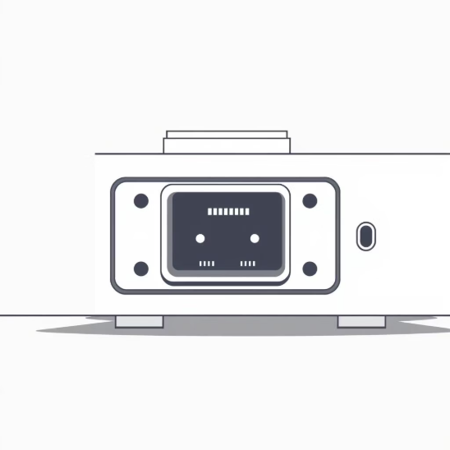
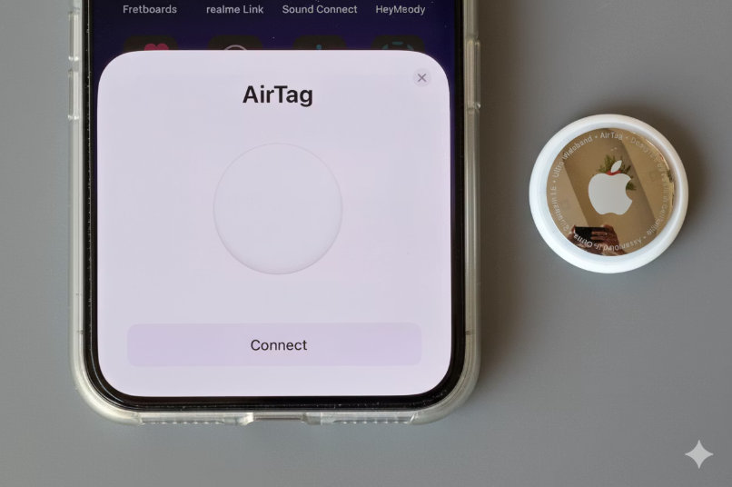
Alternative WPAN Technologies
While Bluetooth and ZigBee dominate, other technologies address specific niche applications requiring high security, line-of-sight, or highly precise location data.
Infrared Data Association (IrDA)
Ultra-Wideband (UWB)
Line-of-Sight: Requires an unobstructed optical path between transmitter and receiver.
Wide Spectrum: Uses very short, low-power pulses across a massive bandwidth (3.1 GHz to 10.6 GHz).
Security: Inherently secure due to extremely short range and directionality.
High Data Rate: Capable of high throughput over short distances (up to 480 Mbps).
Application: Used historically for file transfer between PDAs/laptops and still used for remote controls.
Ranging: Exceptional capability for highly accurate indoor location and ranging (centimeter-level precision).
Notes:
Click to add Notes

Slide 7



WPAN Trends and IoT Integration
The evolution of WPAN technologies is inextricably linked to the rapid expansion of the Internet of Things (IoT), requiring seamless, interoperable, and scalable communication.
BLE & IoT Backbone
IPv6 Integration (6LoWPAN)
Interoperability (Matter)
Bluetooth 5's extended range and mesh support (Bluetooth Mesh) position it as a primary control network for smart homes and industrial IoT.
Technologies like Thread and ZigBee use 6LoWPAN (IPv6 over Low-power Wireless Personal Area Networks) to route IP traffic over low-power links, crucial for end-to-end cloud connectivity.
The new Matter standard aims to unify smart home device connectivity, leveraging Thread (based on 802.15.4) and Wi-Fi, enhancing WPAN device compatibility.
Notes:
Click to add Notes

Slide 8
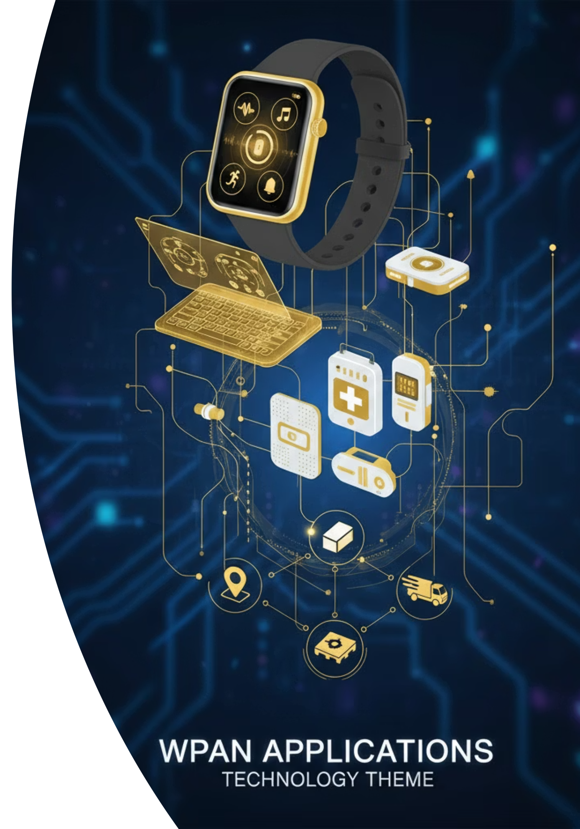
Diverse Applications
Body Area Networks (BAN)
1
Personal health monitoring via wearable and implanted sensors communicating health data to a central device (e.g., smartwatch or gateway).
Personal Peripherals
2
Connecting human interface devices (HIDs) such as wireless keyboards, mice, and audio headsets to computers and mobile devices.
Smart Home Control
3
Automating residential environments using ZigBee, Thread, or BLE for lighting, climate control, and security systems.
Precision Location (UWB)
4
Used for highly accurate indoor positioning, access control (digital keys), and real-time asset tracking in industrial or healthcare settings.
Notes:
Click to add Notes

Slide 9

Conclusion and Key Takeaways
WPAN Core Definition
WPANs are fundamentally characterized by short-range, low-power operation, making them efficient for personal space connectivity.
Critical Tradeoffs
Network design involves balancing three factors: range, data throughput, and power consumption—the defining characteristic of WPAN optimization.
Essential Role in IoT
WPAN technologies are now essential for enabling the vast array of personal, wearable, and local sensor-based Internet of Things applications.
For further study, focus on the details of IEEE 802.15 sub-standards, specific BLE profile layers, Thread architecture, and the implementation of UWB localization algorithms.
Notes:
Click to add Notes

Slide 10

References
Standards Organizations
Industry Alliances
IEEE 802.15 Working Group: Defining WPAN standards (e.g., 802.15.1, 802.15.4).
Connectivity Standards Alliance (CSA): Driving standards like ZigBee and the Matter protocol.
Bluetooth Special Interest Group (SIG): Overseeing Bluetooth Classic and BLE specifications.
Infrared Data Association (IrDA): Maintaining the optical wireless communication standard.
Thank You for watching this presentation.
Please feel free to reach out with any questions or further inquiries.
Contact: it21001@mbstu.ac.bd
<number>
Notes:
Click to add Notes

